Slide 1
Introduction
Melek Mizher
MSDS 453
Walter: Chemical Element Information Chatbot.
It can also provide summaries about every element.
Can take both Element names or Symbols as recognized inputs for the system.
Dataset generated by extracting information from Wikipedia articles on each of the Elements.
Word Analysis Leveraging Tendencies of Elements for Restricted Reasoning (Walter)
Notes:
Walterr or Walter for short. Word Analysis Leveraging Tendencies of Elements for Restricted Reasoning

Slide 2
Problem Definition
Walter allows for retrieval of quick answers about different Chemical elements.
The purpose is purely for entertainment although it does have potential for basic educational purposes.
I will be teaching this material to my students next week. Can be useful for them to use to learn more about the different elements.

Slide 3
Methods
Data extracted from Wikipedia using their API.
Walter uses a mixture of Rule-Based actions with AI-Based actions.
Rule-Based part allows it to introduce itself, greet user, asks for name and confirms element of interest.
AI-Based part processes user input and produces an answer to user question. If Summary is requested Summary is extracted from article directly using Wikipedia API.
Models tested so far include distilbert-base-cased-distilled-squad and

Slide 4
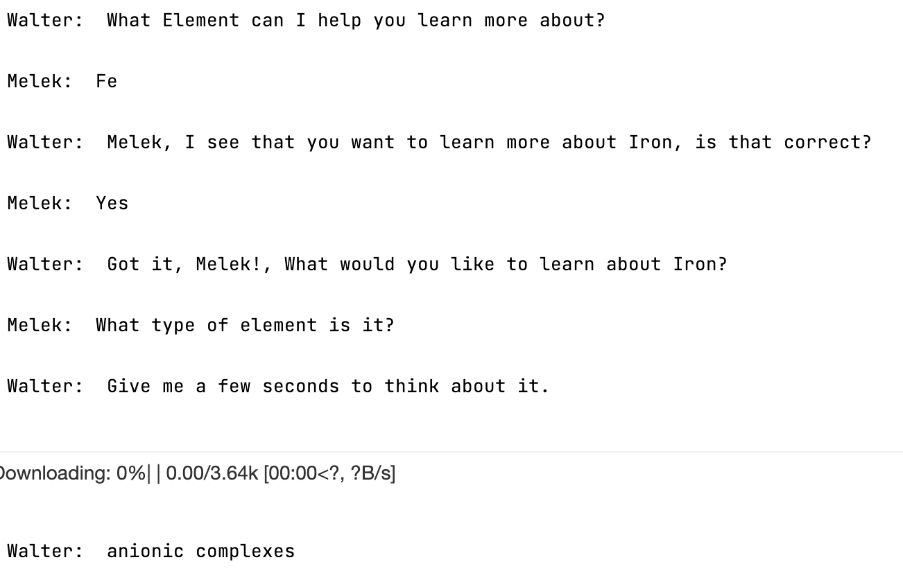
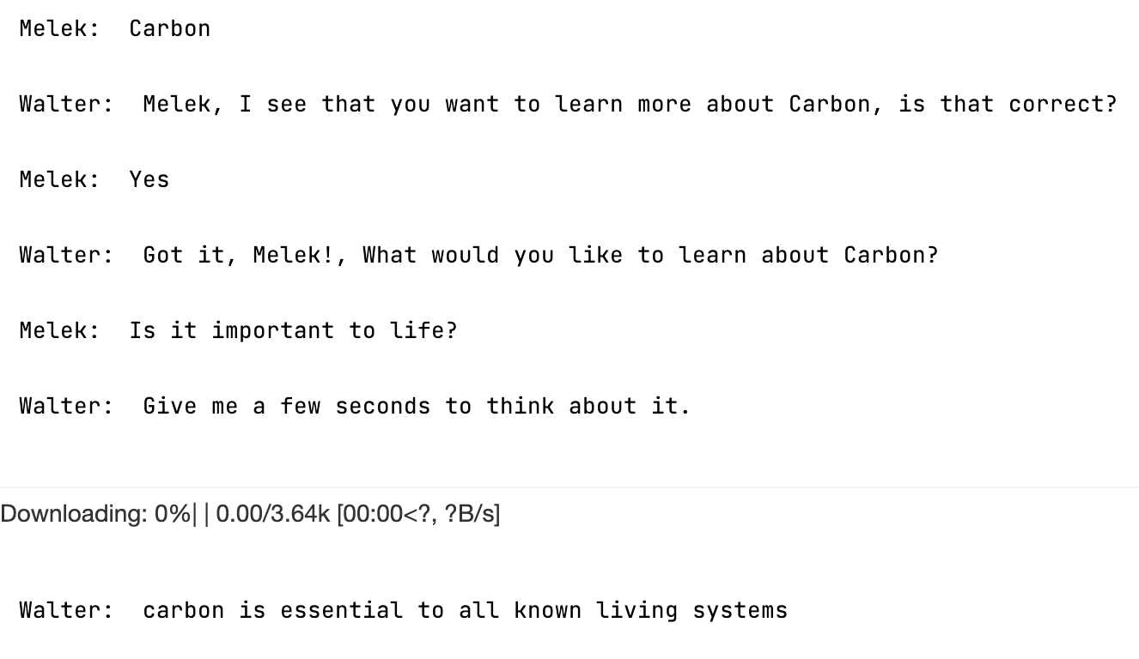
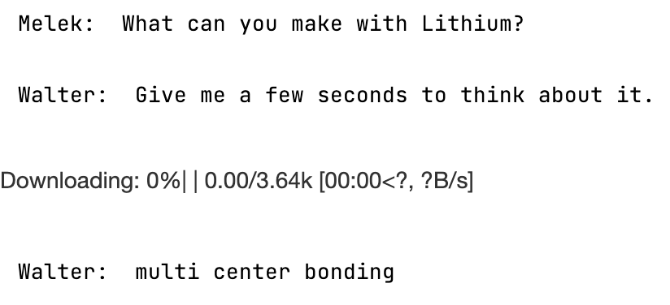
Results
Model = distilbert-base-cased-distilled-squad Revision = 626af31 Extractive Model

Slide 5
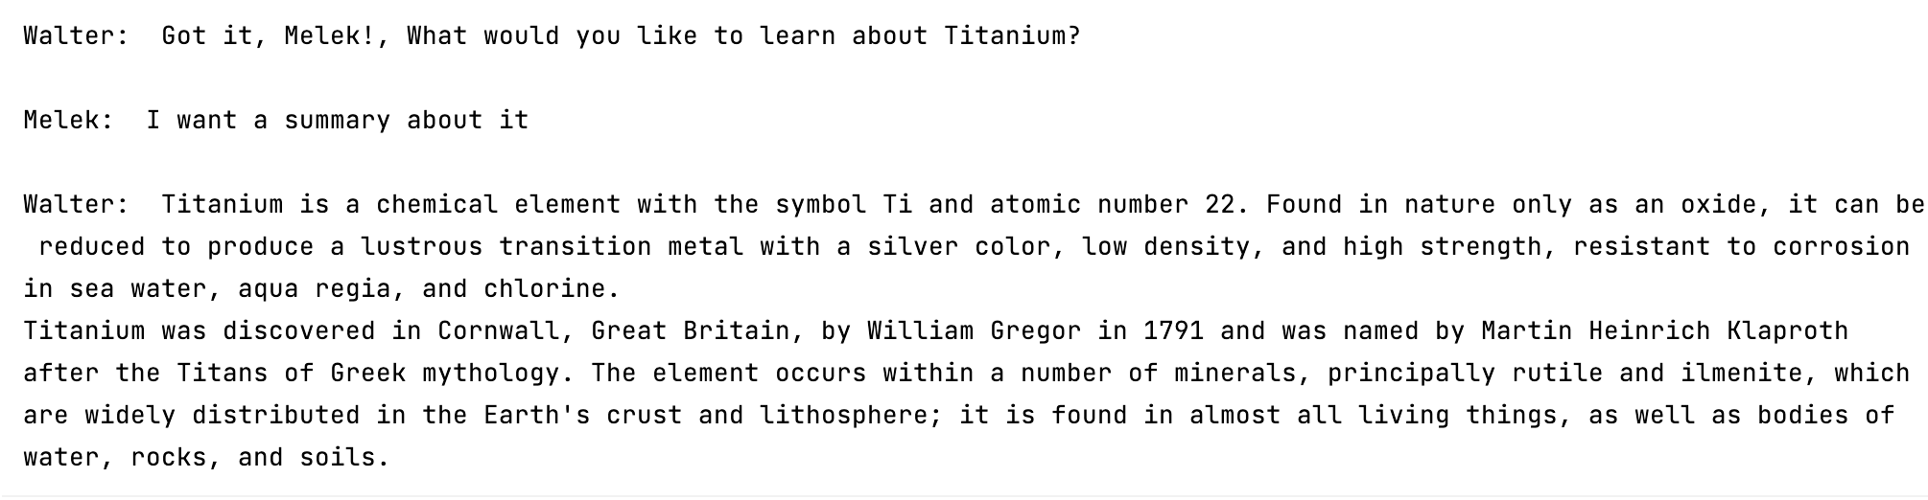
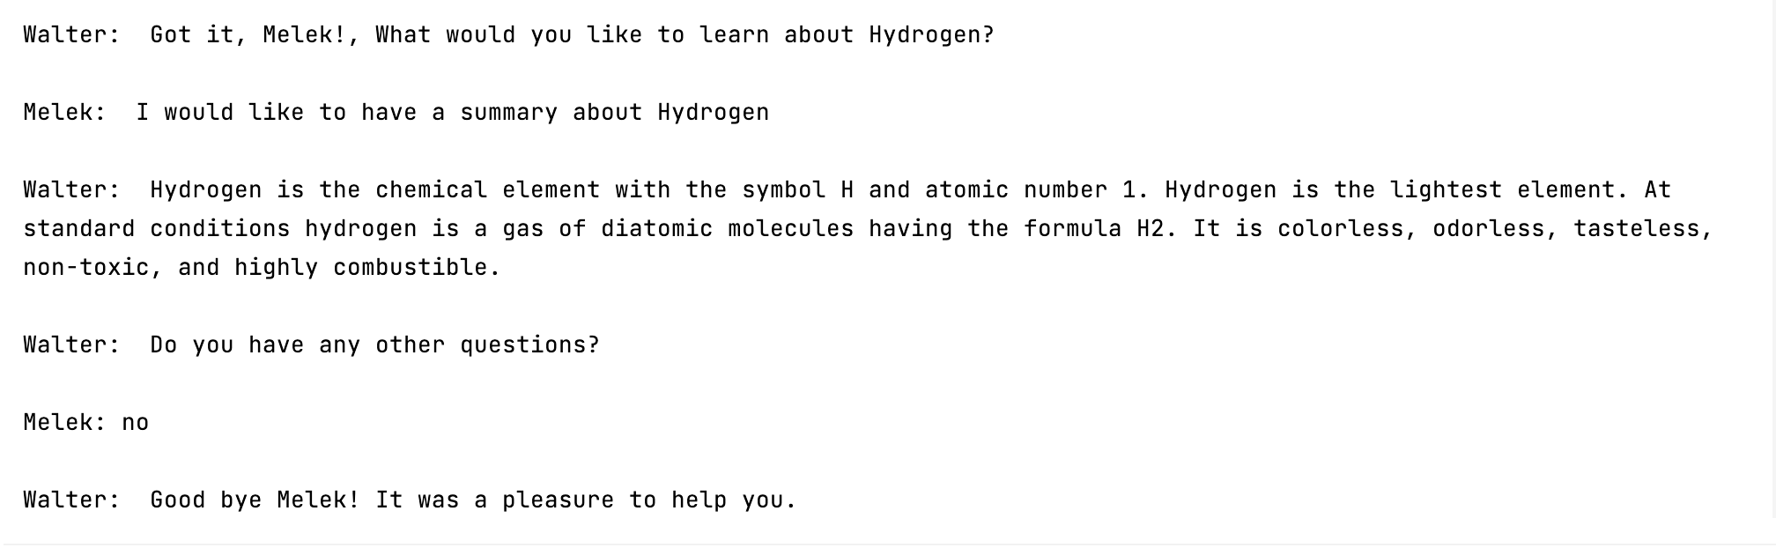
Titanium
Hydrogen

Slide 6
Conclusions / Recommendations
Walter is still pending the creation of a manual algorithm / TF-IDF that uses strictly the information given.
Currently uses Wikipedia article as context instead of as the only source of data. Differences between algorithms creates a large effect.
Not friendly to misspellings or punctuation in its current iteration.
This brings the need for a Knowledge Graph to the spotlight to ensure correct text understanding.

